Slide 1

First-Year Programs
Central Connecticut State University

Slide 2
First Year Experience Taskforce
Formed in 2019
Three Subcommittees
  Pre-collegiate
  First-year course
  Engagement
Mission Statement: The First Year Experience at CCSU is a comprehensive, deliberately integrative program that supports the academic and personal growth of all students transitioning to the university.
Vision Statement: First Year students are engaged in a vibrant and supportive CCSU campus community in which they develop the foundational skills necessary to reach their full potential.
Strategic Plan - Goal 1.2.A , “Provide a comprehensive, multi-faceted first-year program to all incoming Undergraduates.”

Slide 3
Task Force Action Items
Leadership – “We recommend a Director or Dean of FYE, or two individuals with shared responsibilities.”
Coordination through Communication – a coordinated approach to all communication with first-year students from pre-admission through the first-year.
Student Advising – Augment student-advisor interactions during orientation. Incorporate faculty-student interactions before/or after convocation.
Information & Resources – Utilize an information hub for first-year students and their families.
Mental Health – Mental health first aid training (Mike Russo), increase awareness of counseling.
Peer Mentorship – Create FY peer mentorship program.
Common and Inspiring Identity – Identify university traditions and create new traditions for FY students
Branding for FYE – Logo and color
Outreach to High Schools – Create an advisor board of high school guidance counselors.
Diversity, Equity, and Inclusion – Ongoing Title IX Training and skill-based workshops in diversity for FY students.
First Year Course – CCSU 103 and the pilot of CCSU 102.
Programmatic Assessment – Utilize NESSE, BESSE, CIRP, and develop new assessment tool.

Slide 4
Subcommittee Outcomes and Recommendations
Develop First-Year Course
Learning Outcomes (Summer 2020)
Comprehensive Campus-wide Onboarding Plan – Office of New Student Programs
Peer Mentor Program
Activity Based Common Experience
Increase Student Engagement
Assessment

Slide 5
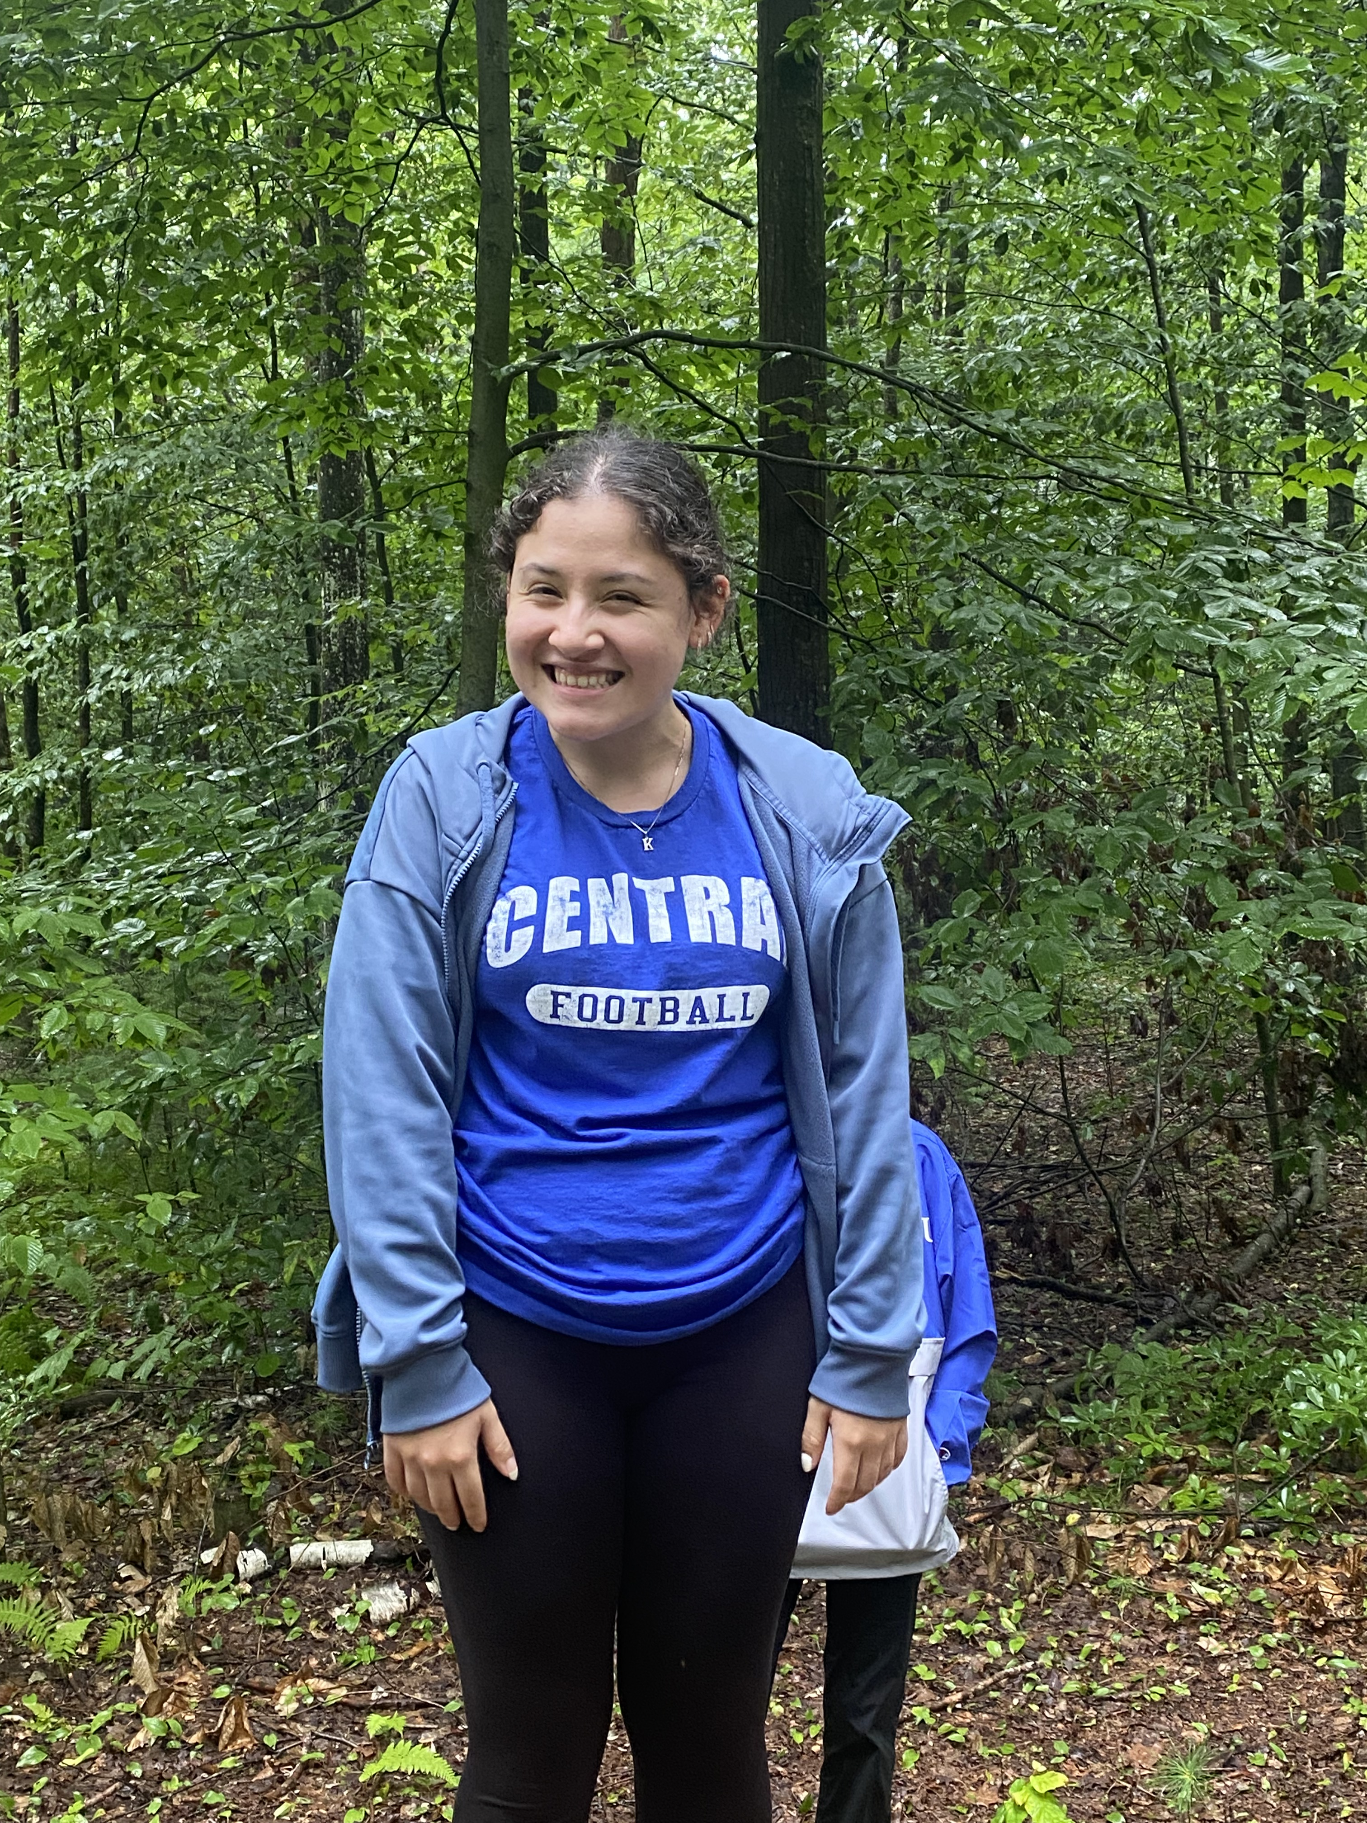
First-Year Course
Fall 2023
  15 CCSU 102 sections
  6 CCSU 103 sections (undeclared)
  1 FYE 101 section (Music)
  26 Embedded sections
Recruiting for Fall 24 currently.
Peer Mentors

Slide 6
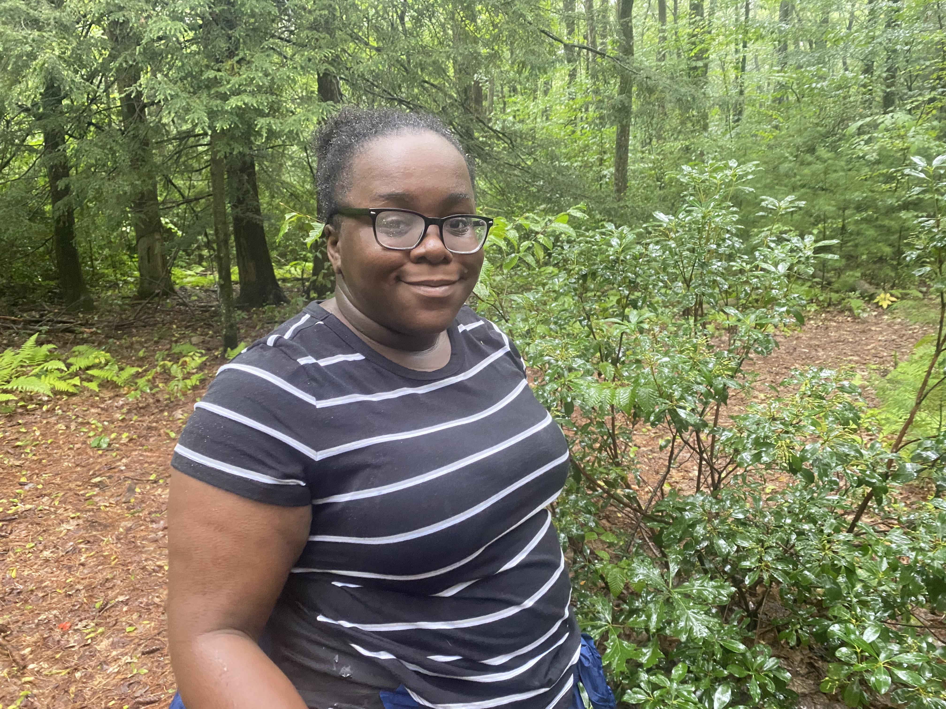
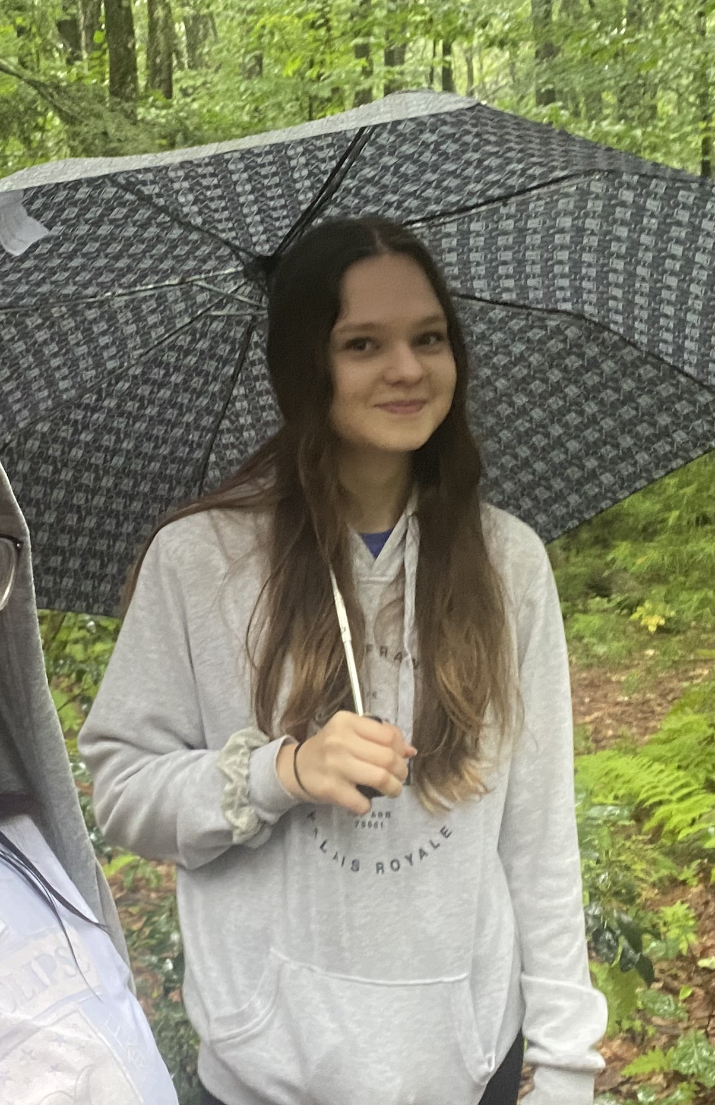
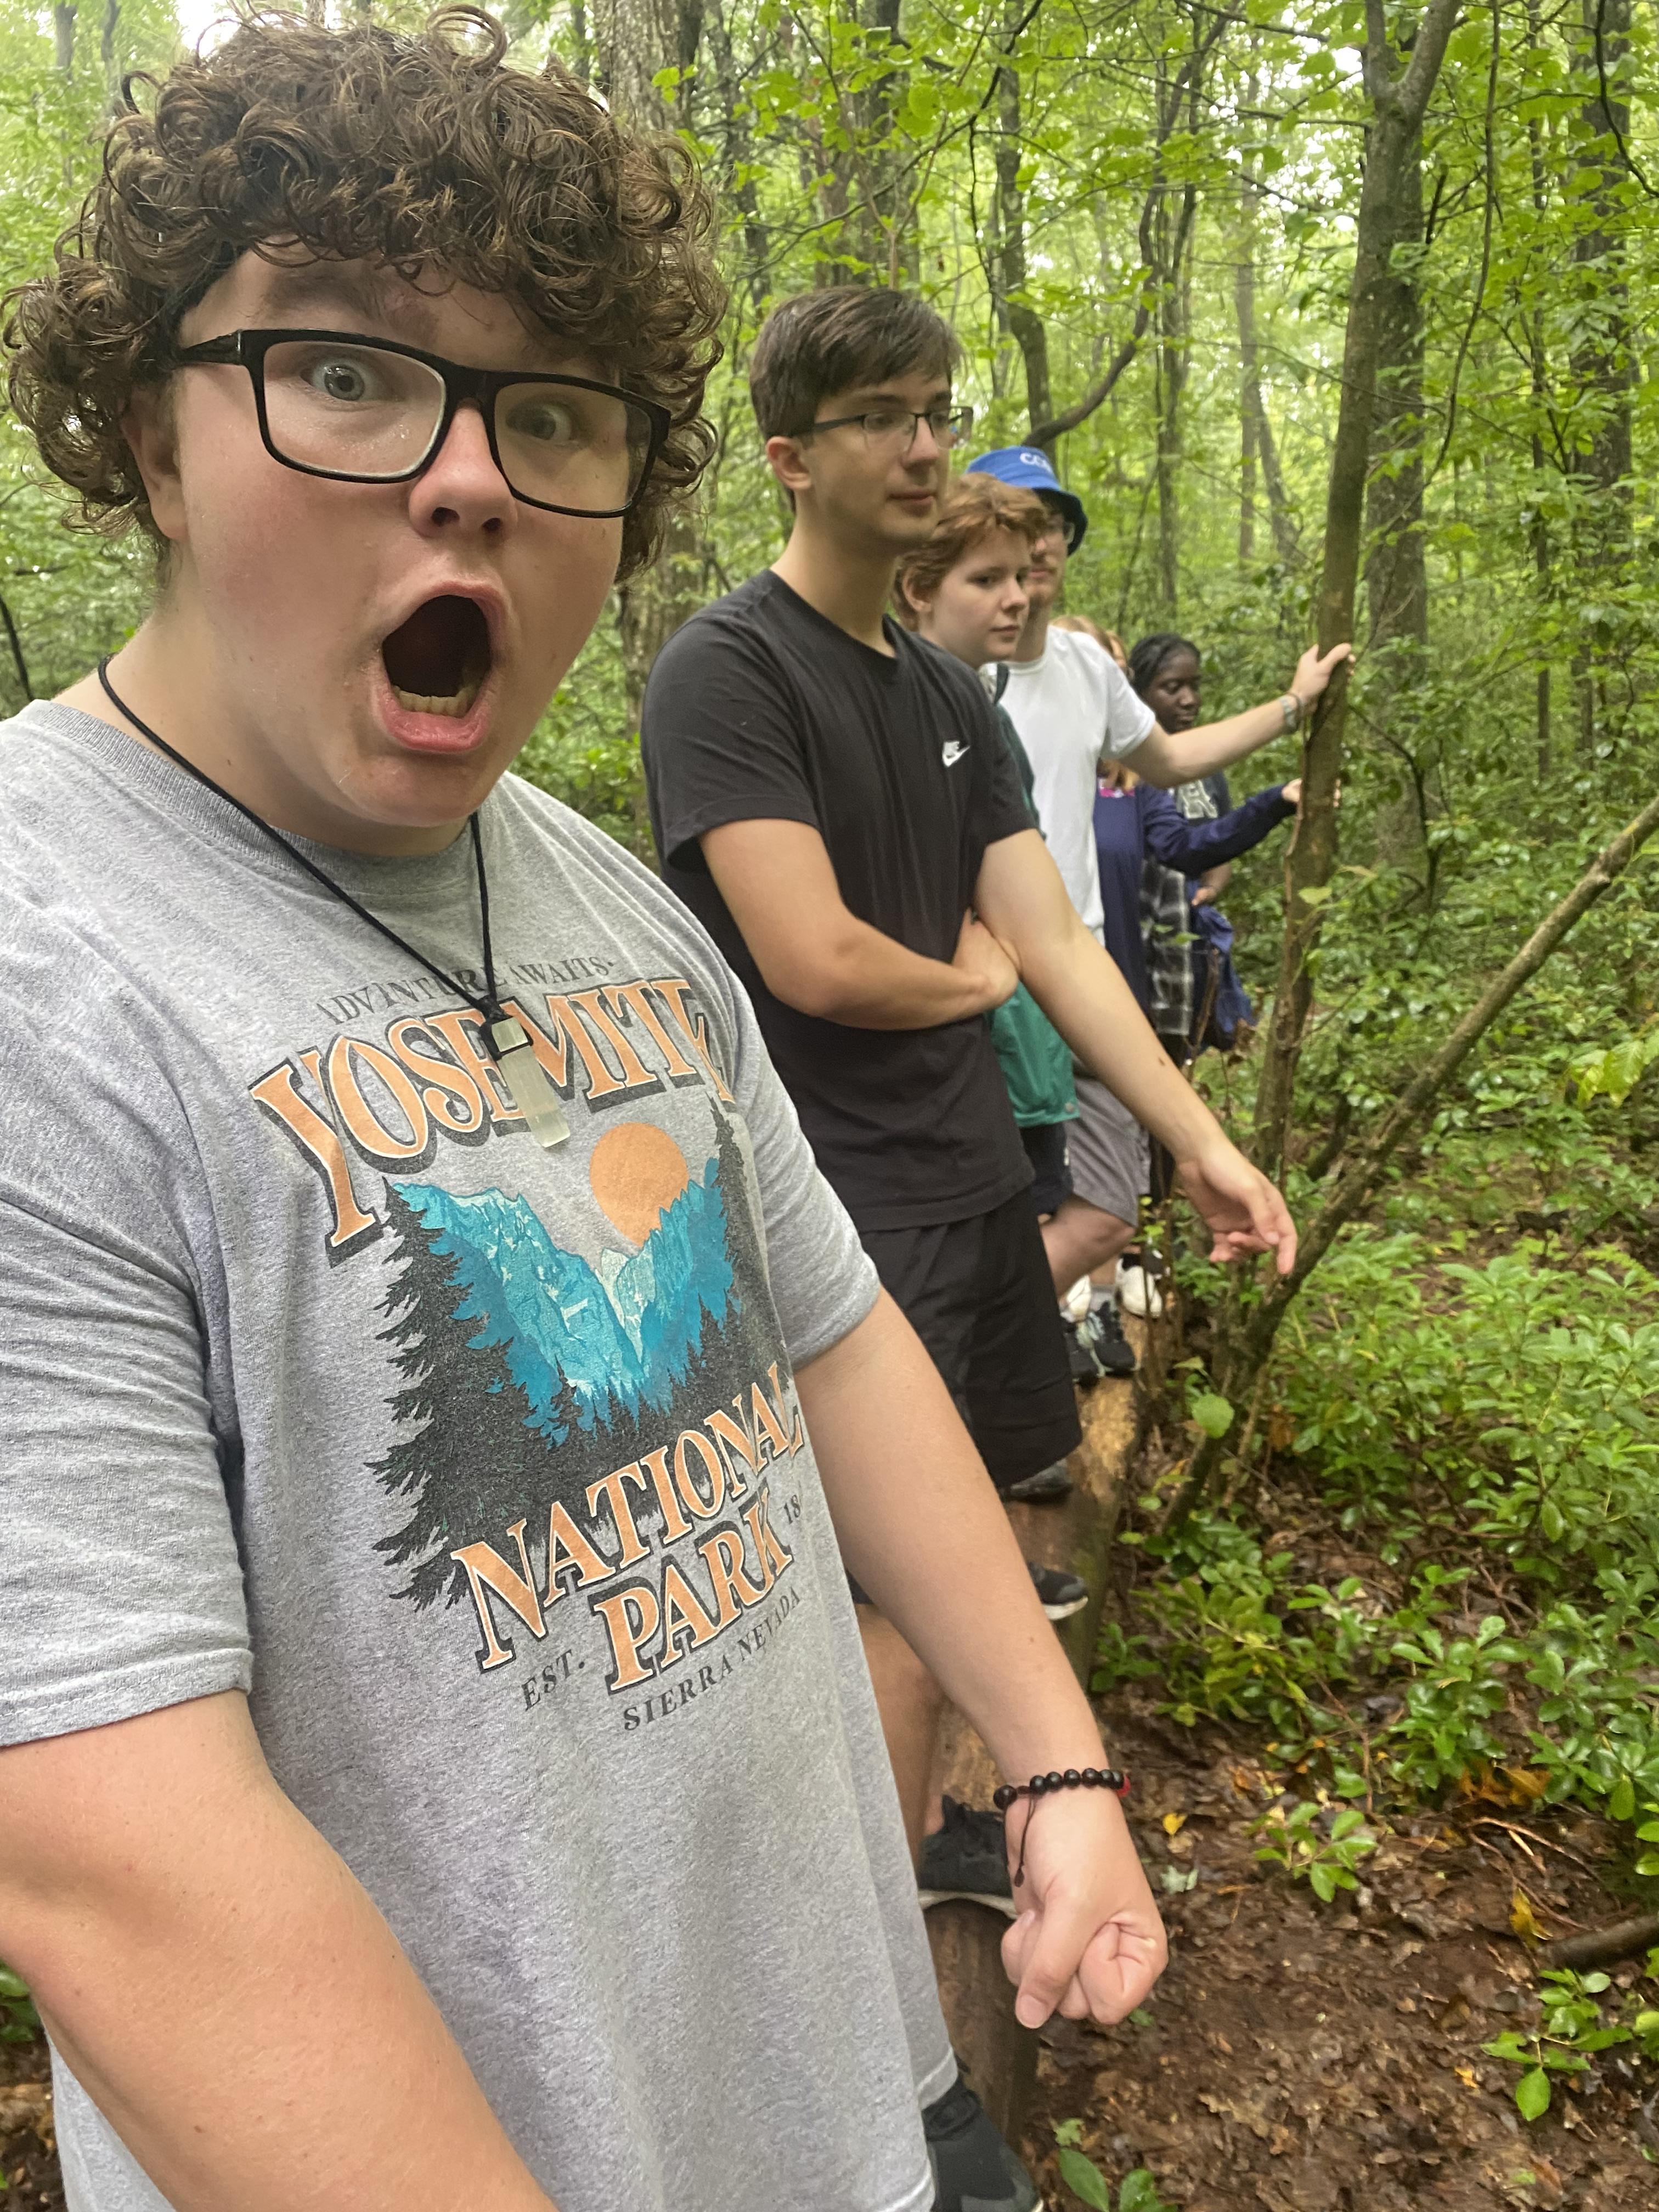
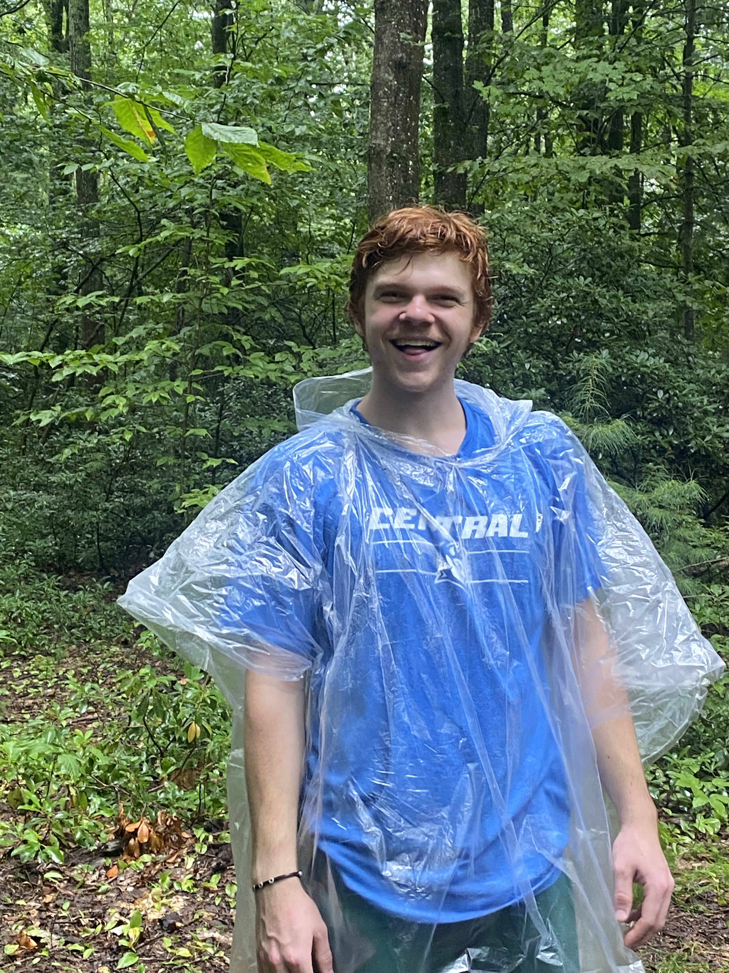
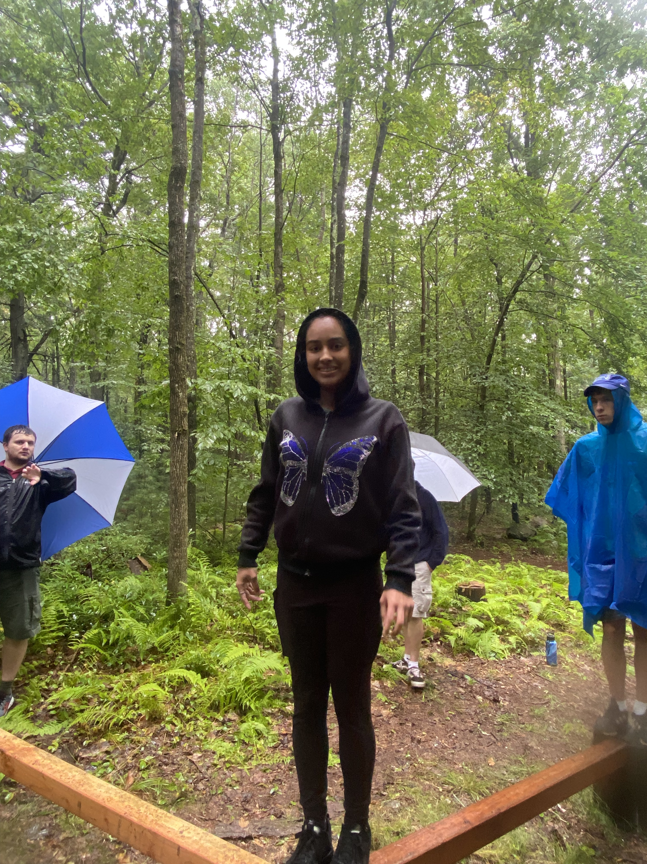
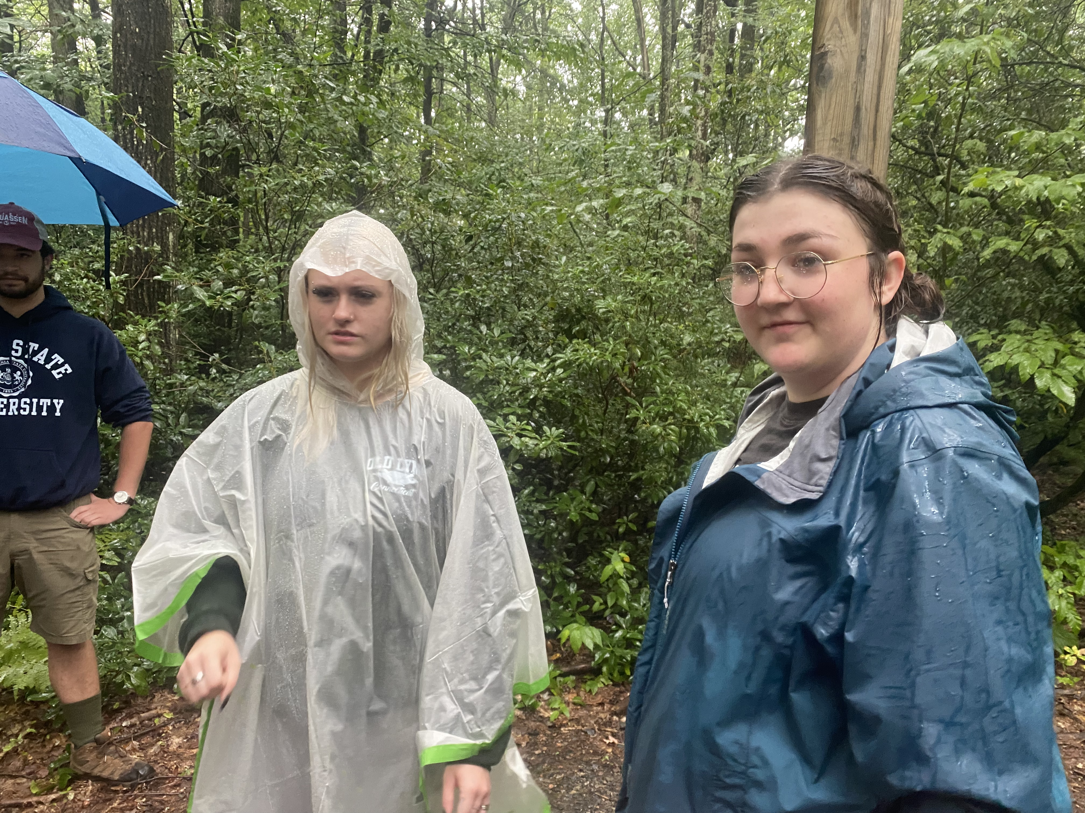
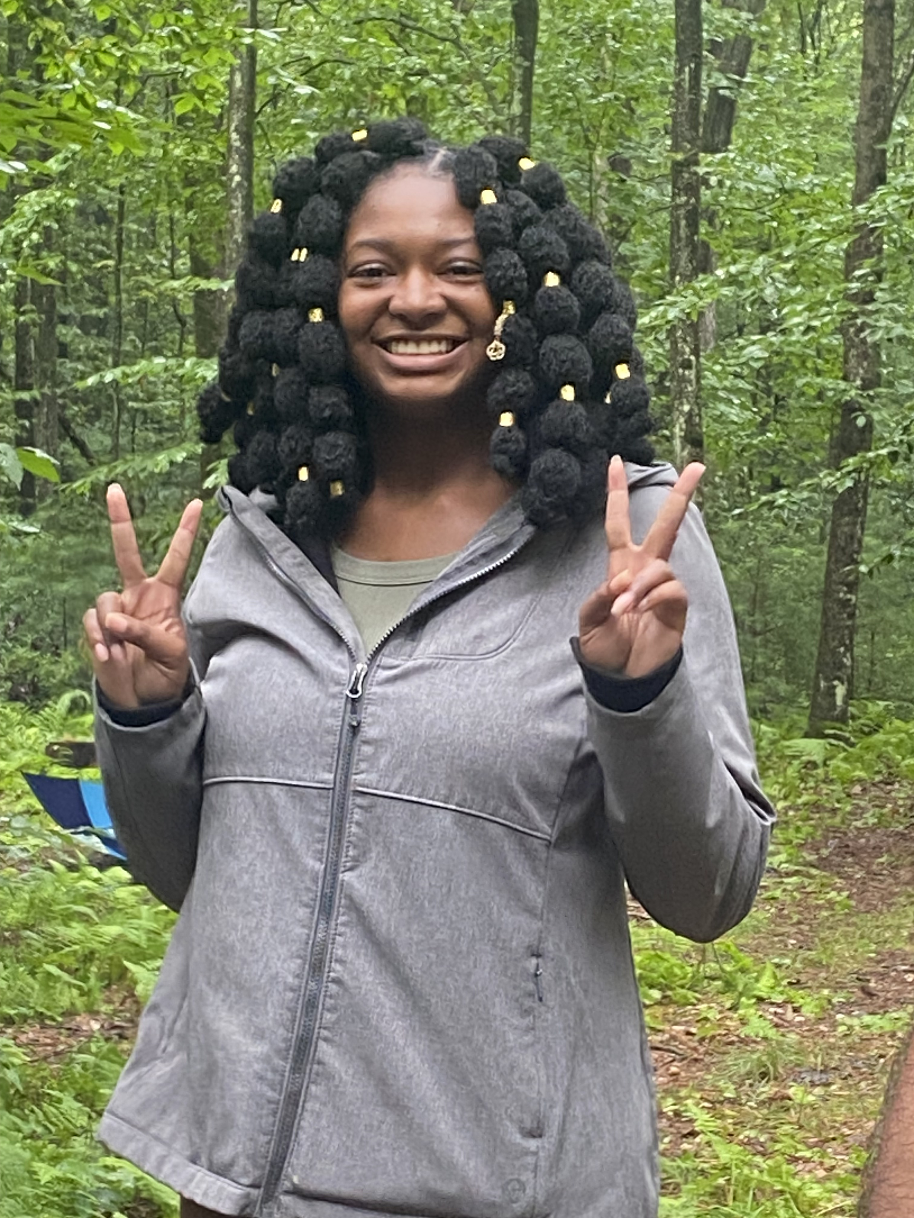
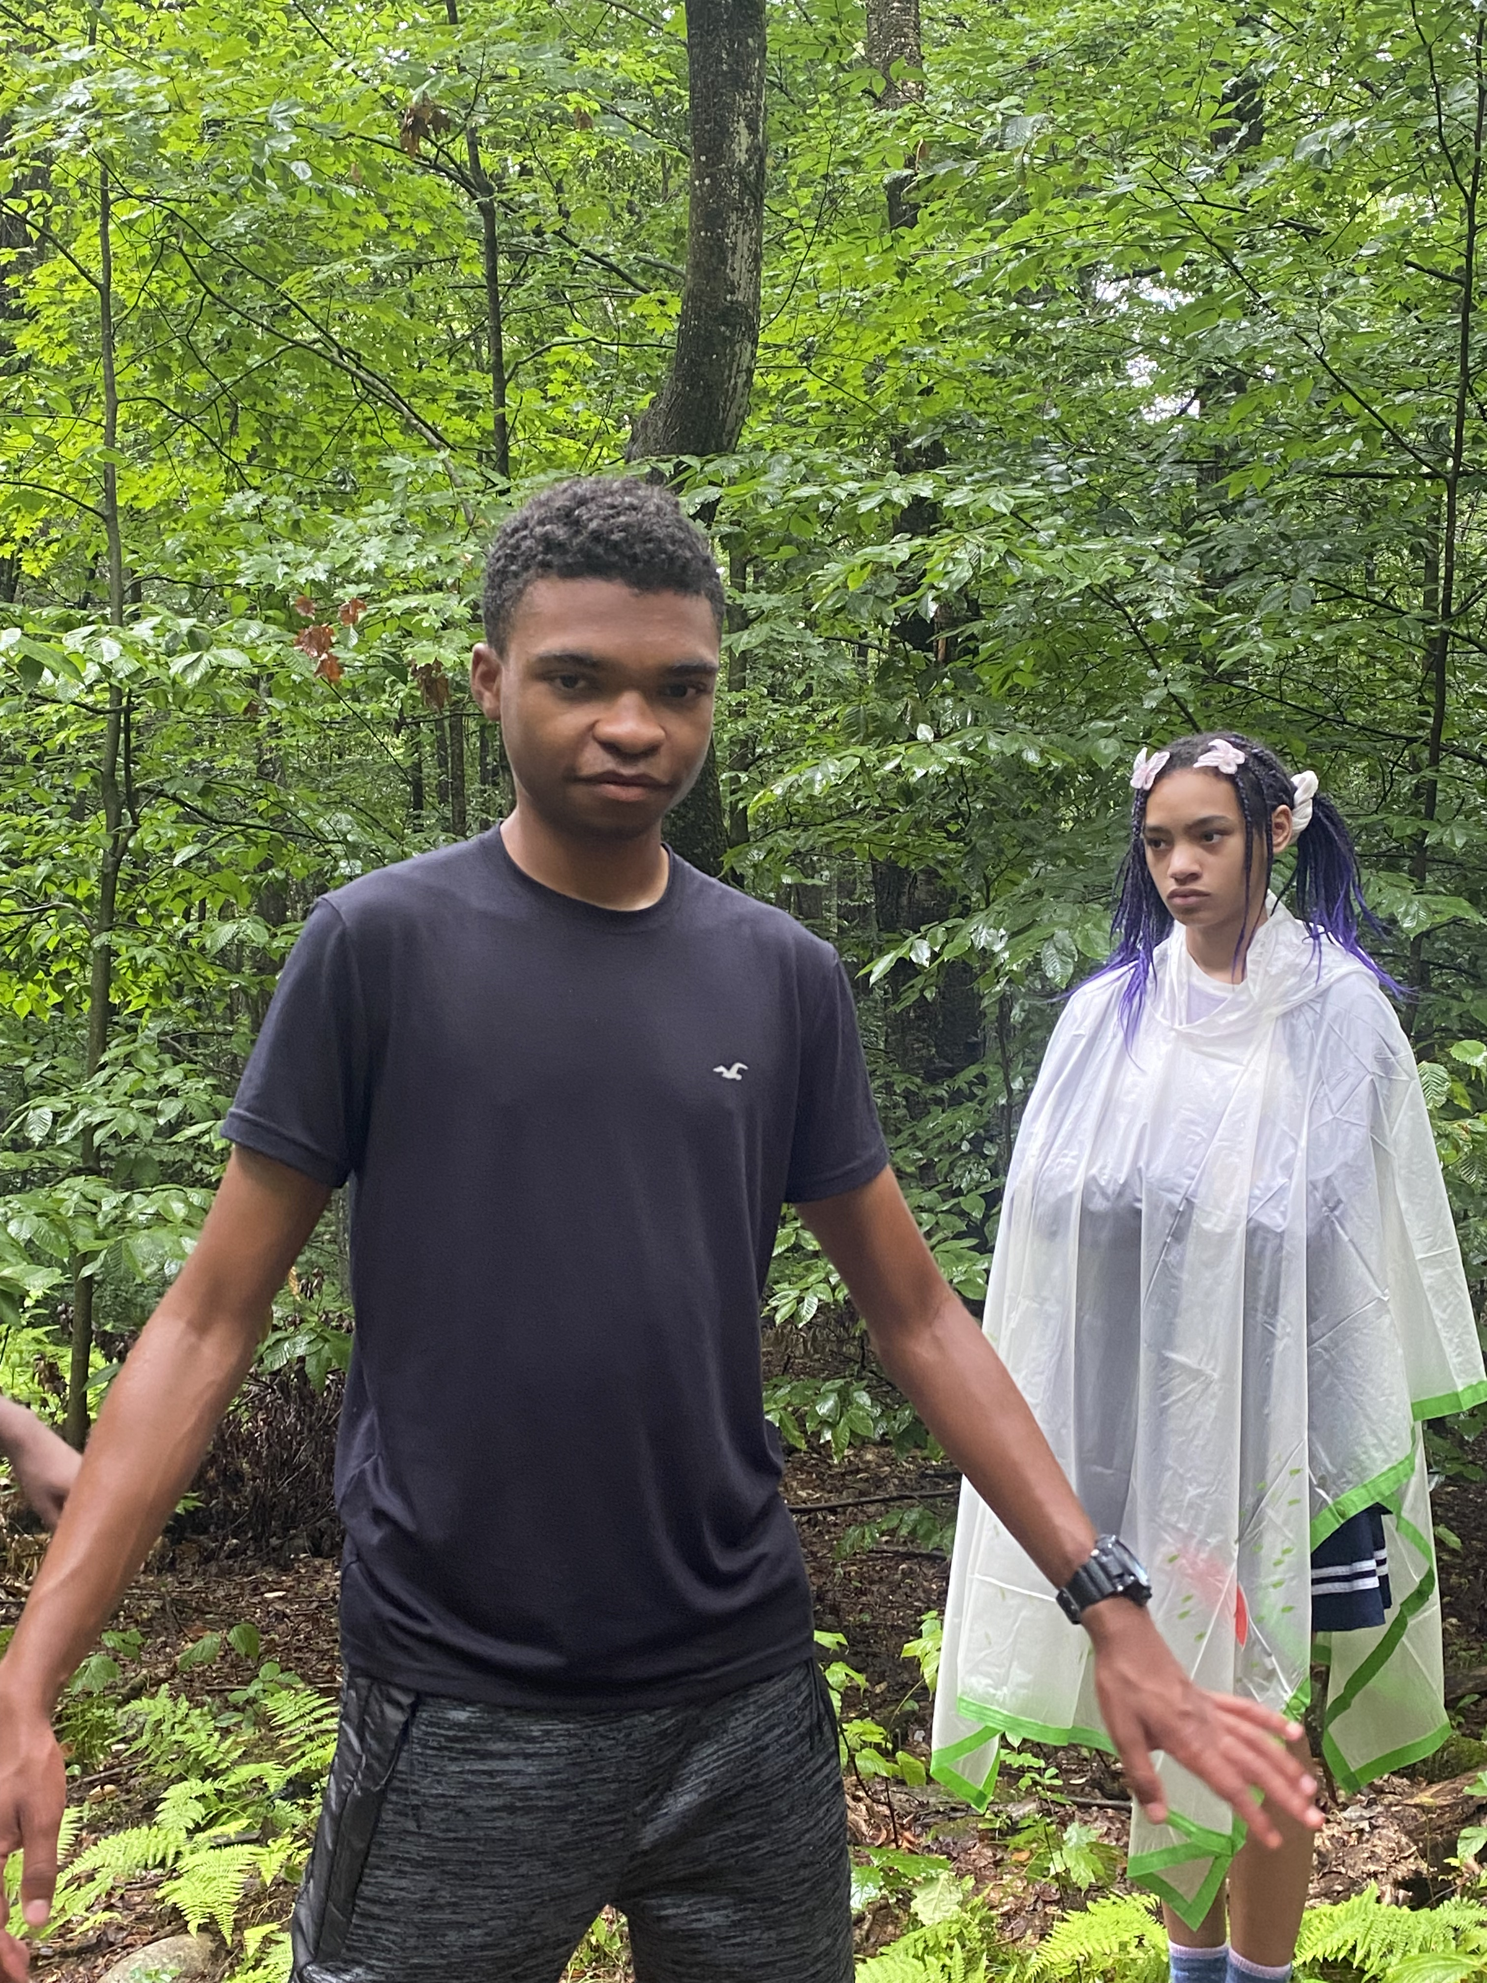
Activity Based Common Experience – CAMP Central

Slide 7
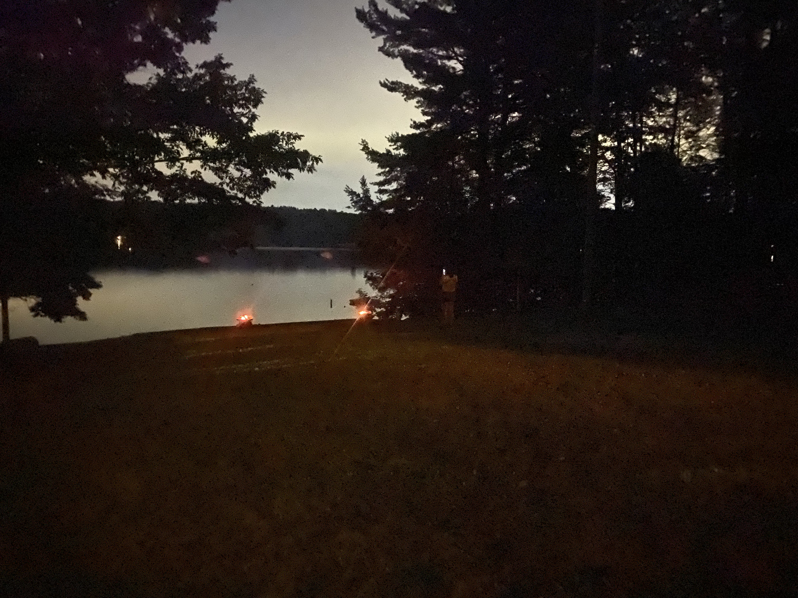
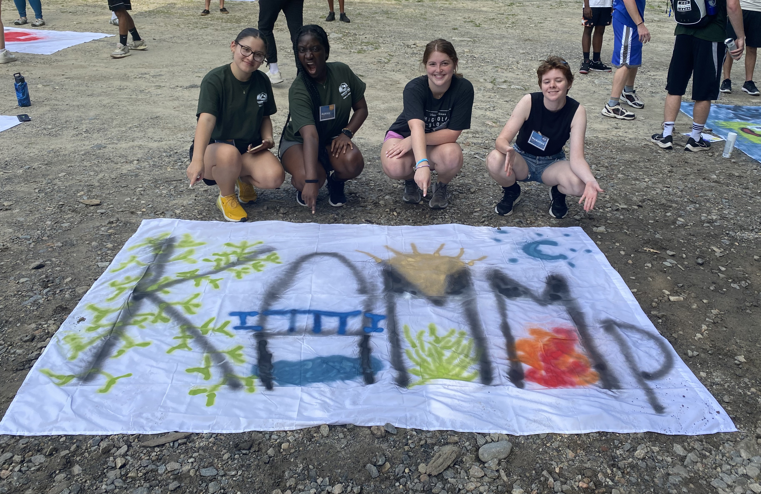
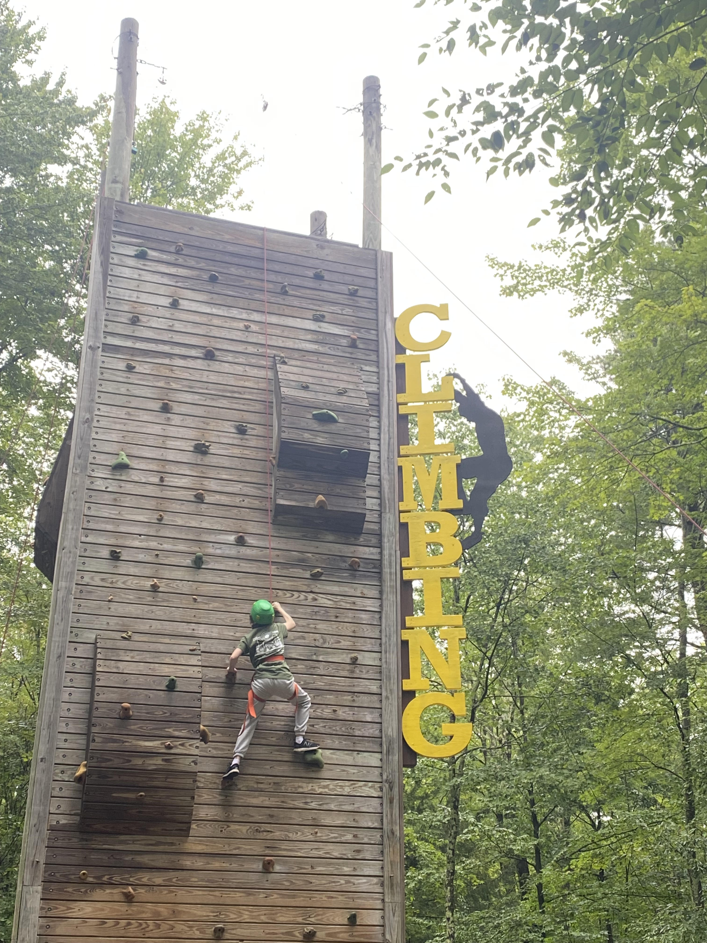
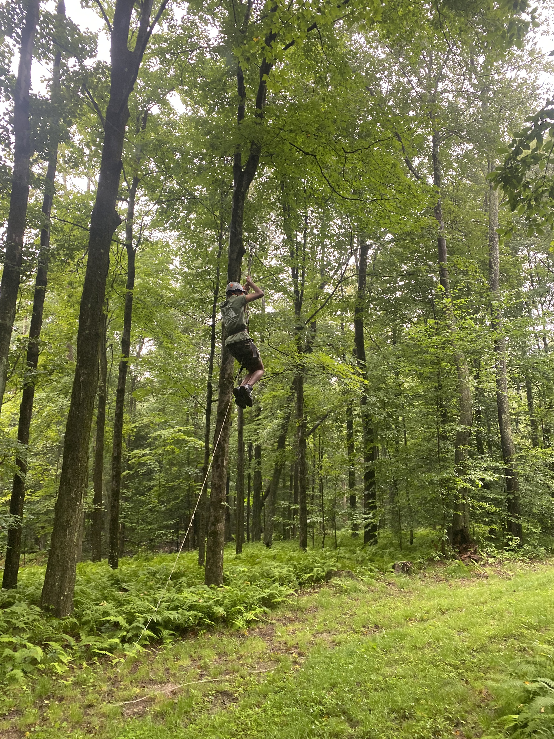
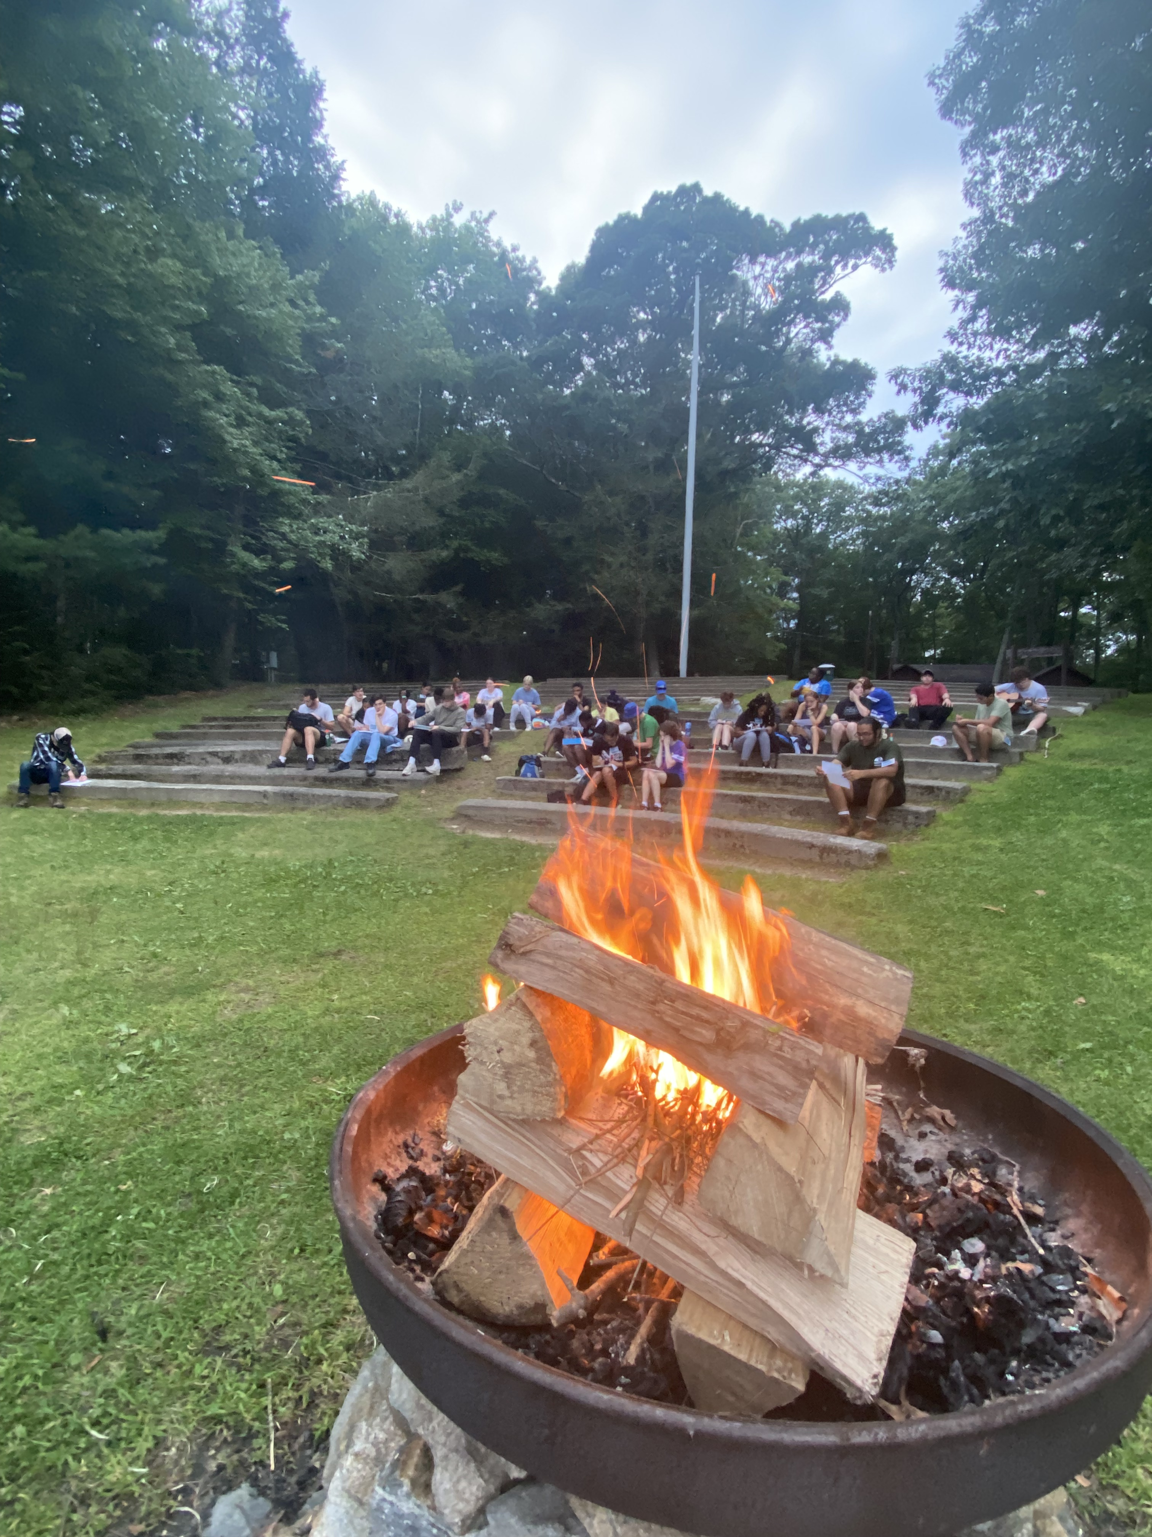

Slide 8
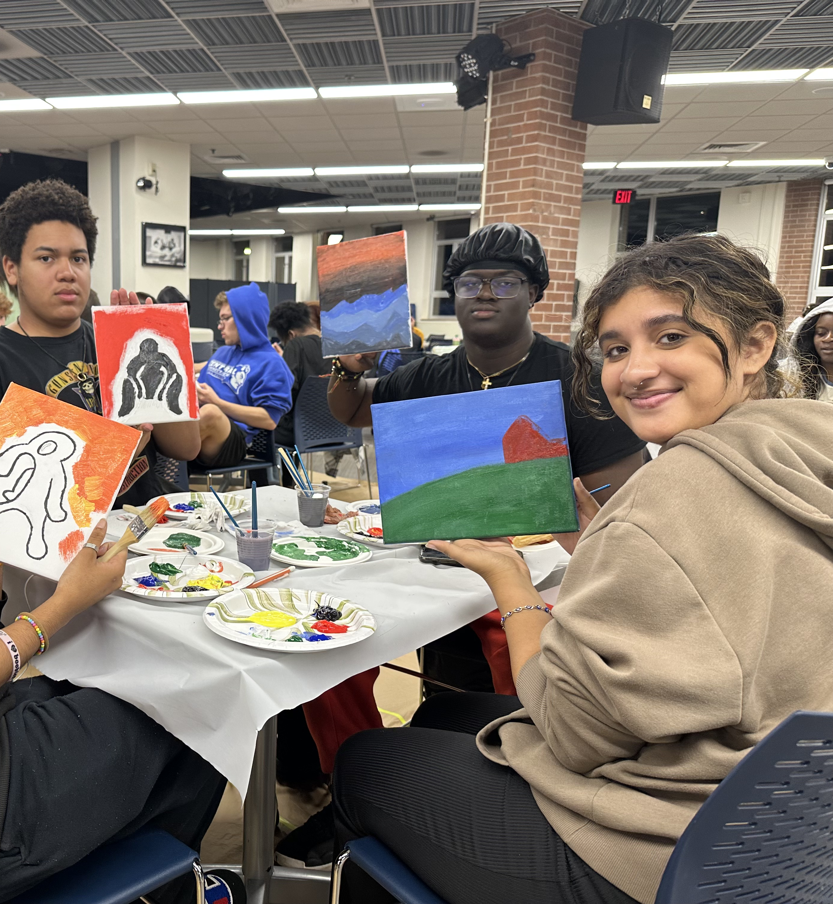
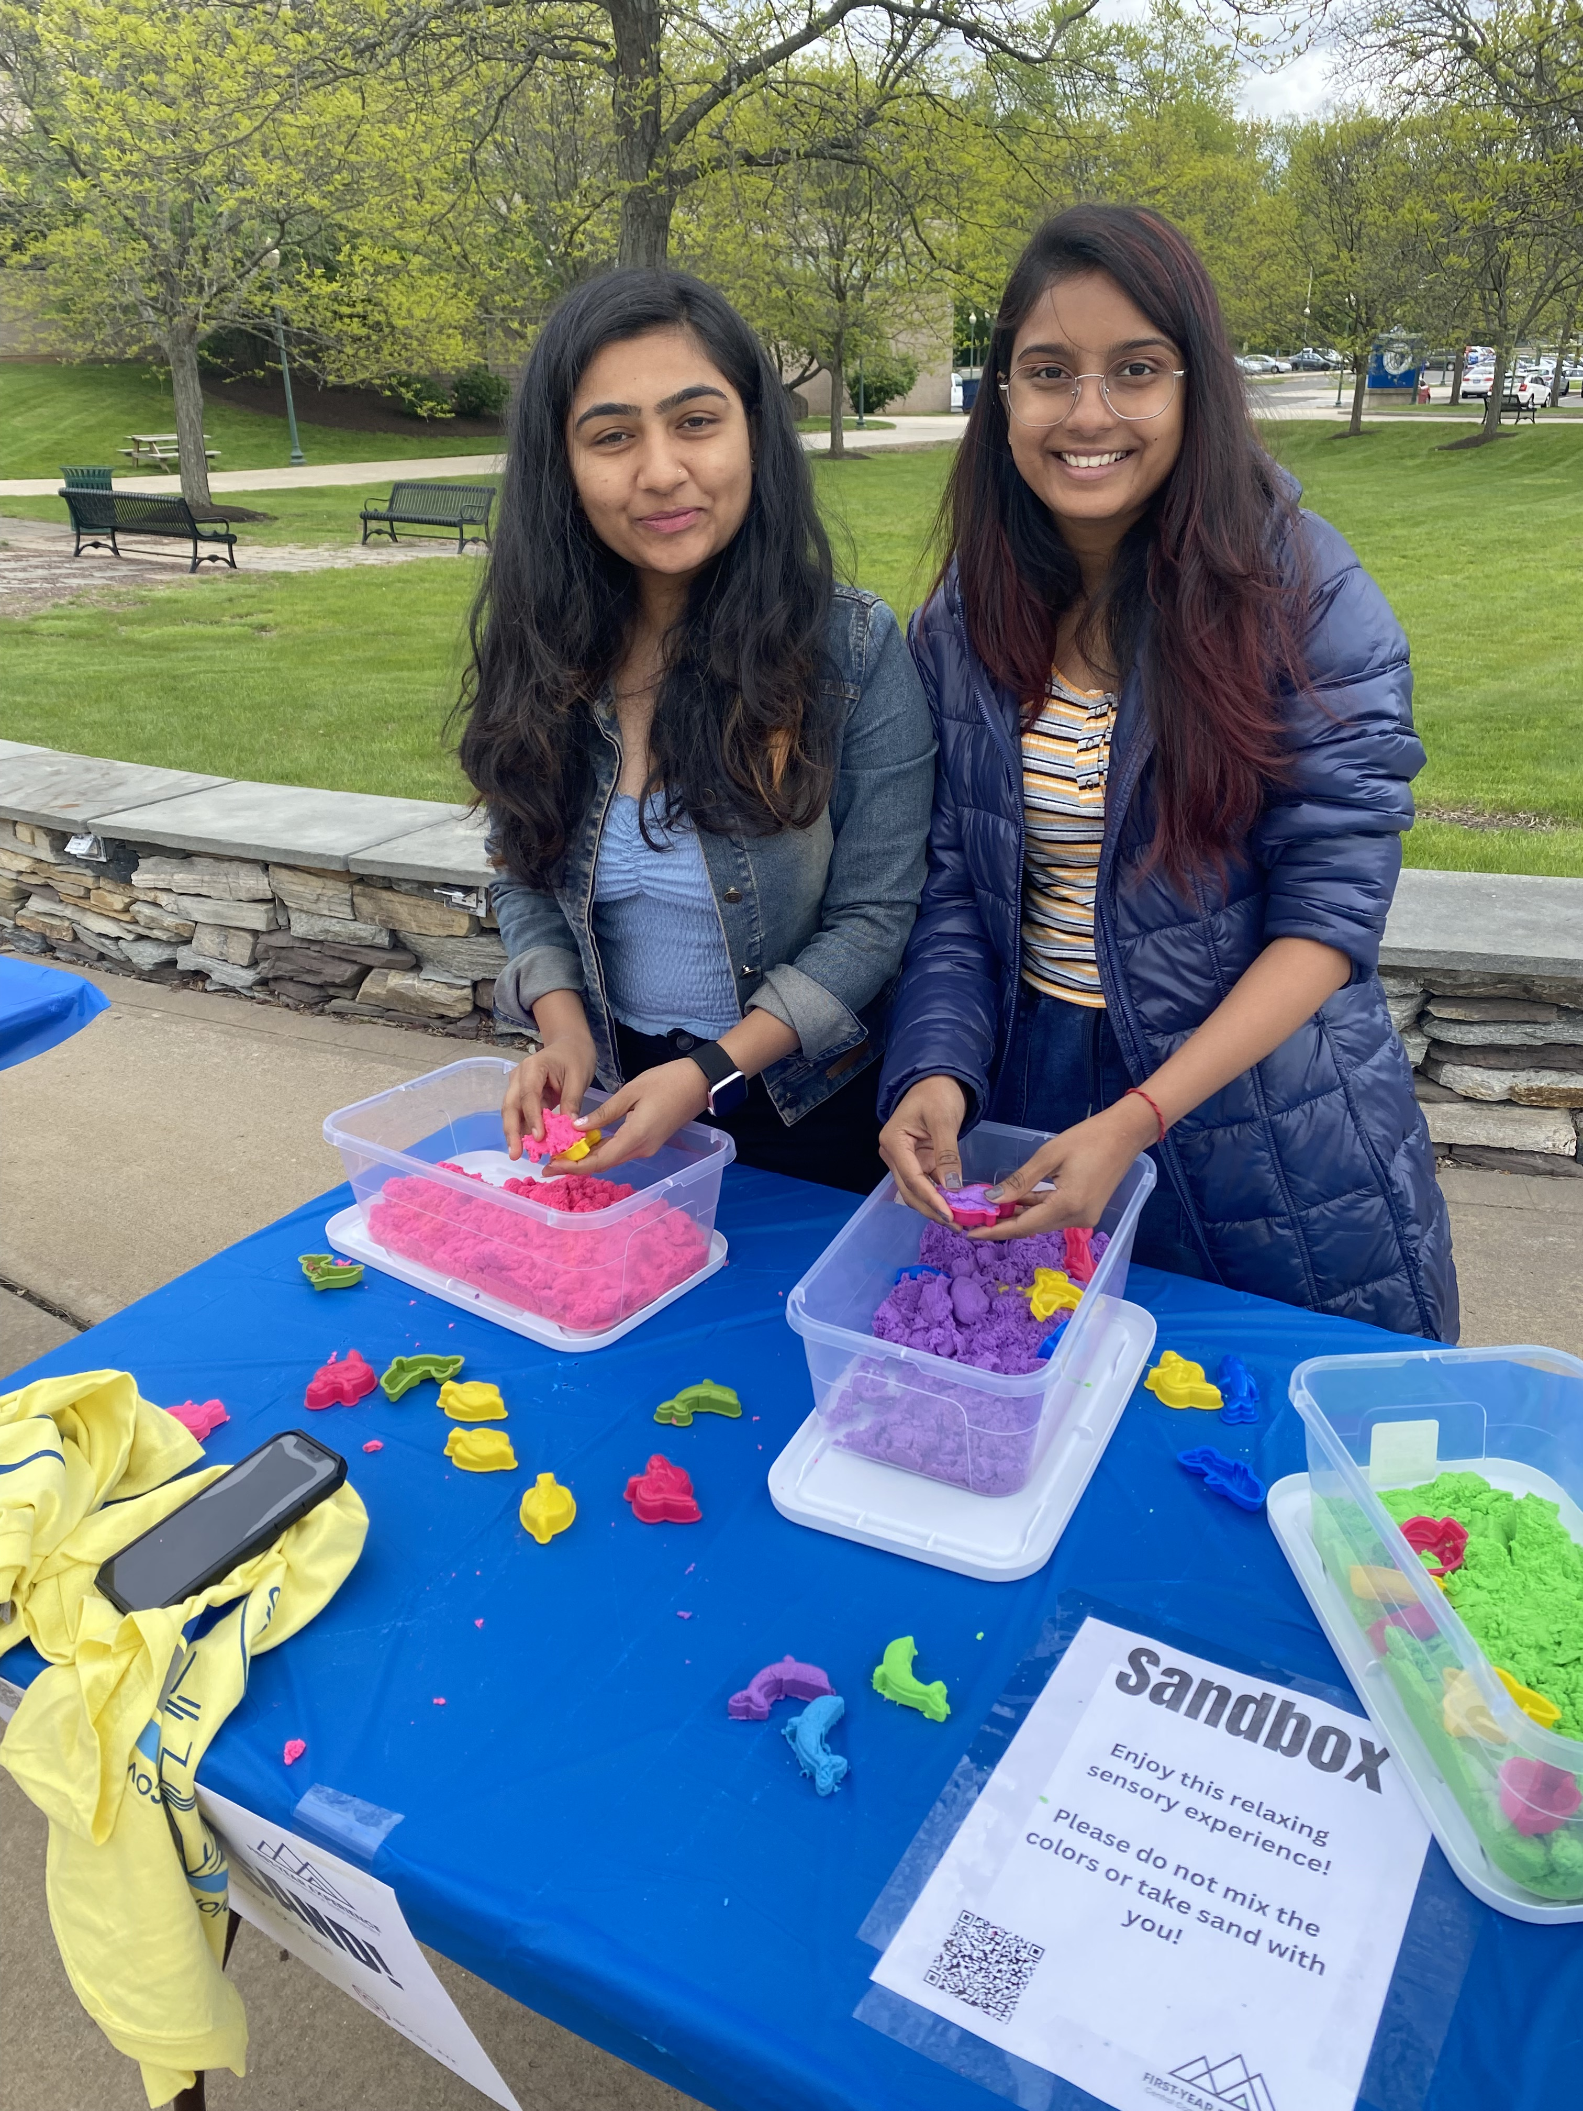
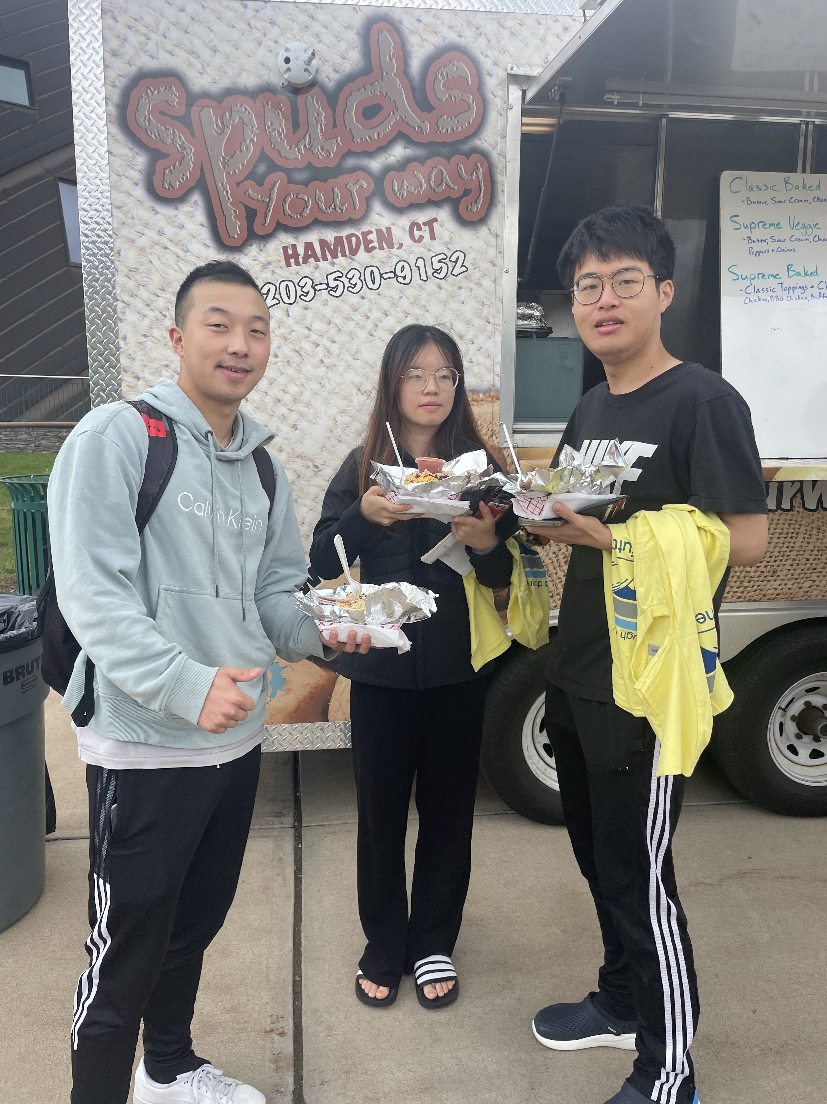
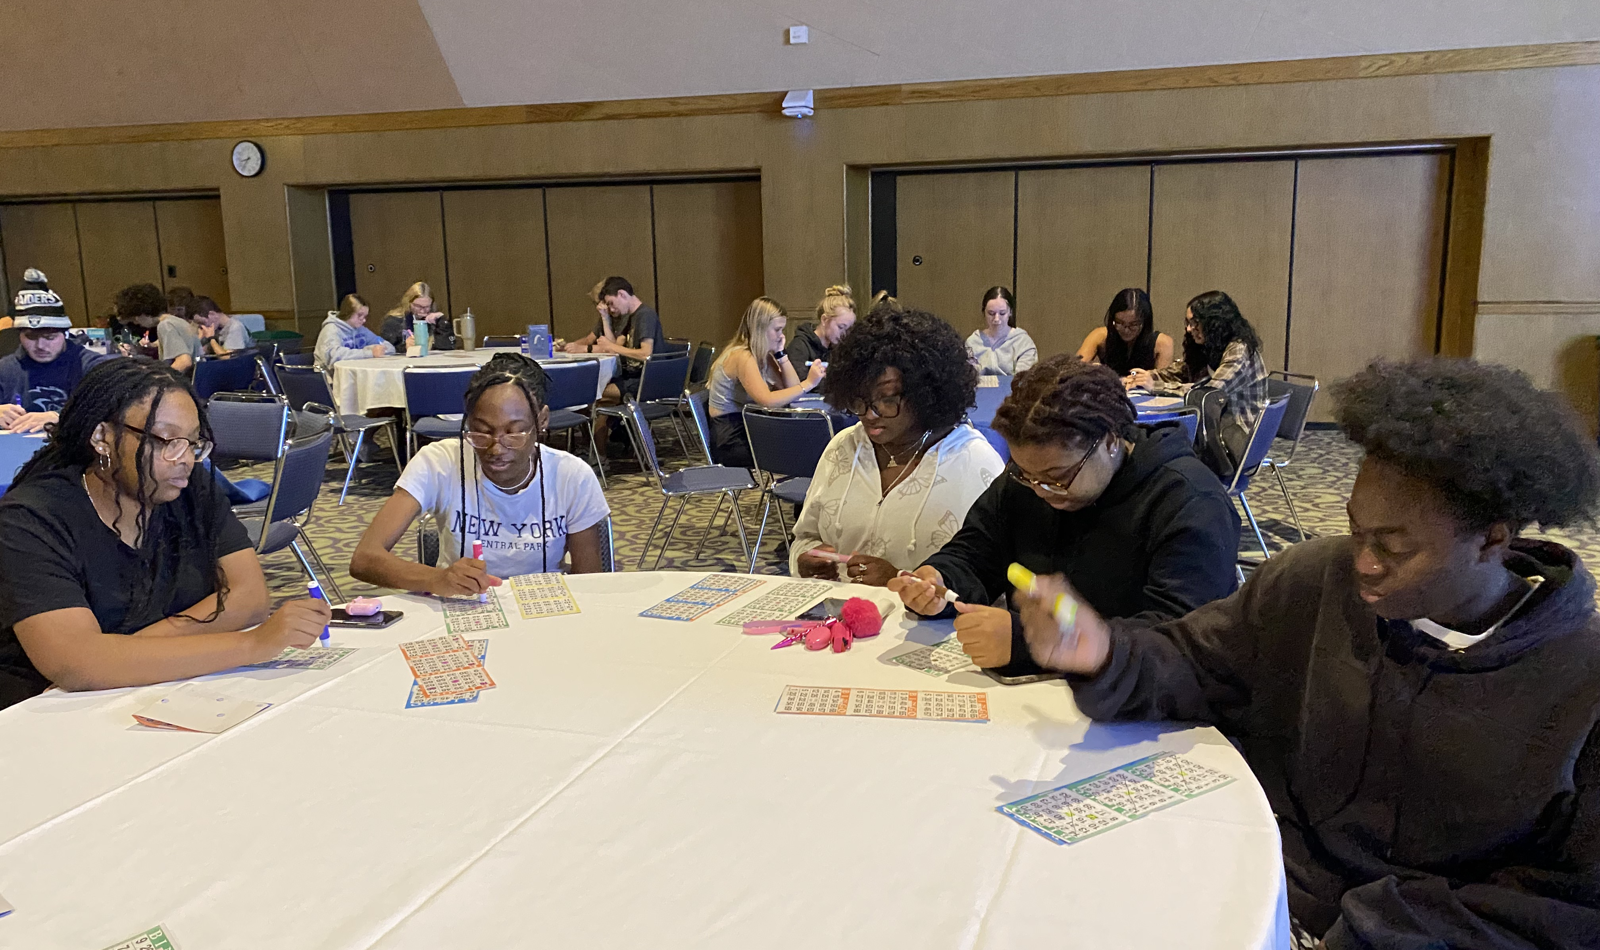
Increase student Engagement

Slide 9
Assessment
Pre-test and post-tests fall 2022 (continuation and variation of pre- and post-test used in fall 21)
  On the fall 2022 post-tests, students expressed higher levels of agreement on a host of questions related to understanding general education, the role of advisors, and their own ability to find important information about majors and minors.
  The students also expressed greater confidence on the post-test on certain academic items including their own notetaking, reading, and writing skills.
  Moreover, almost 80% of respondents noted agreement with the statement, “I have a positive relationship with at least one faculty member.” and they indicated strong positive relationships with their academic advisors.
  Areas of concern included a reticence to contact faculty members when they needed assistance and lower than expected class participation rates.

Slide 10
